Slide 1

Week 3
Networking with the Pico W
Fundamentals of IoT
Dr. Eoin Rogers (eoin.rogers@tudublin.ie)

Slide 2
Lesson Outline
Quick refresher on networking
Connecting the Pico to the Internet via wi-fi
Using the sockets API to send and receive data
Basic processing of the data using string/bytes manipulation functions/methods

Slide 3
Networking
A quick refresher on modern computer networking

Slide 4
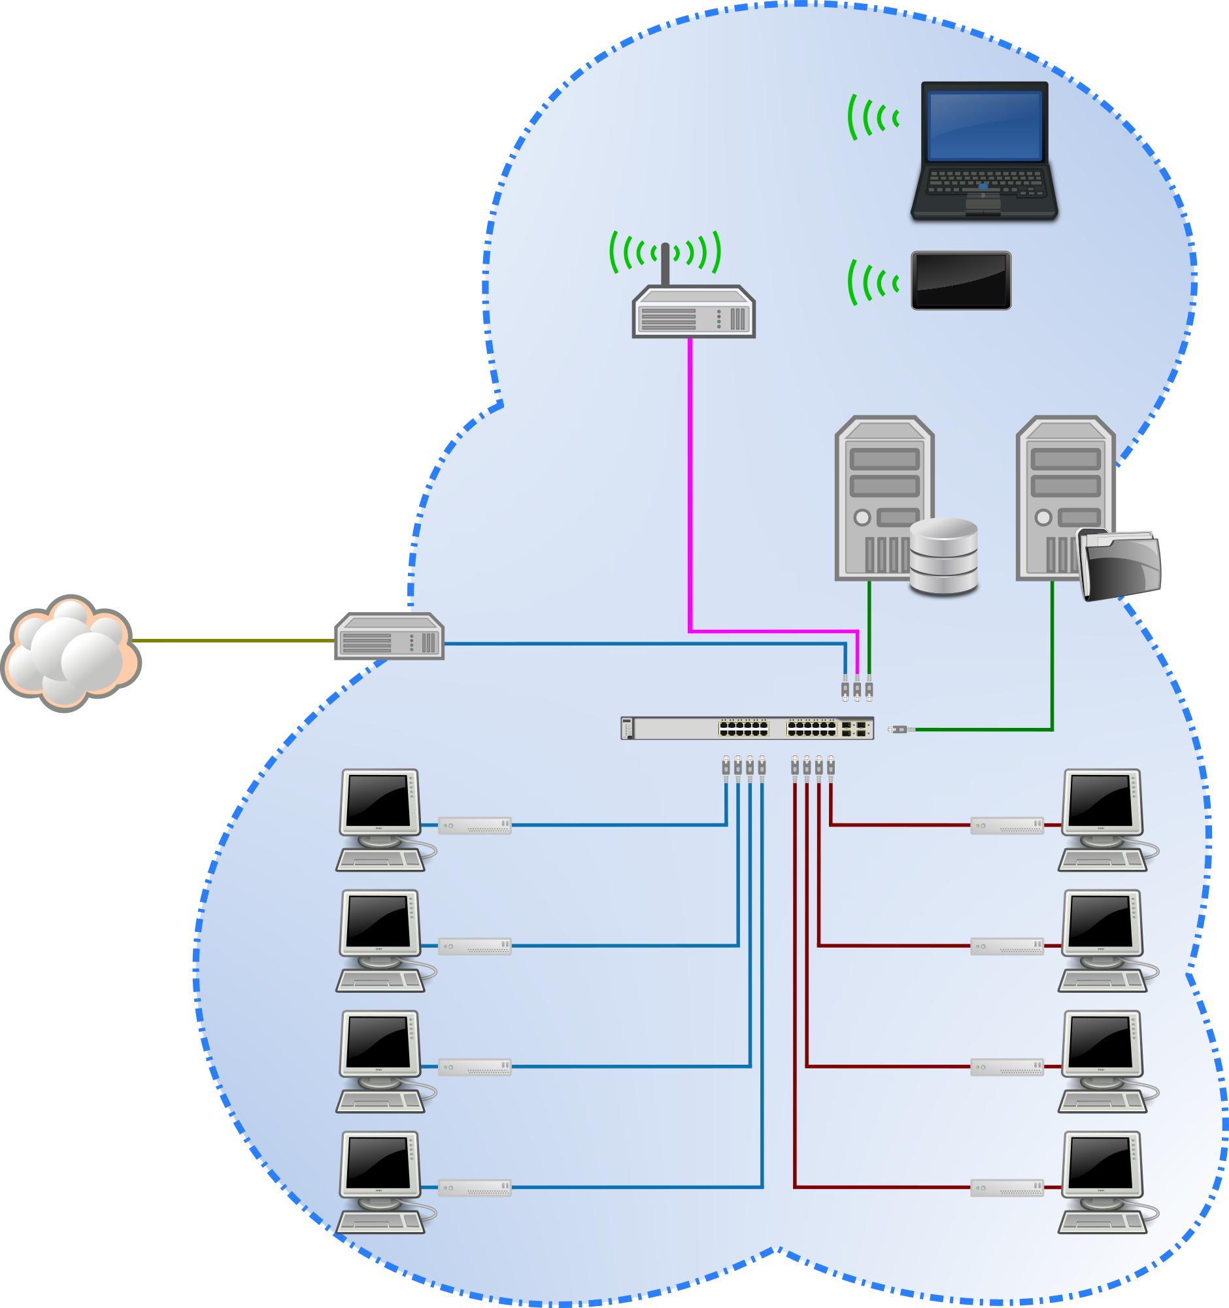
Networking

Slide 5
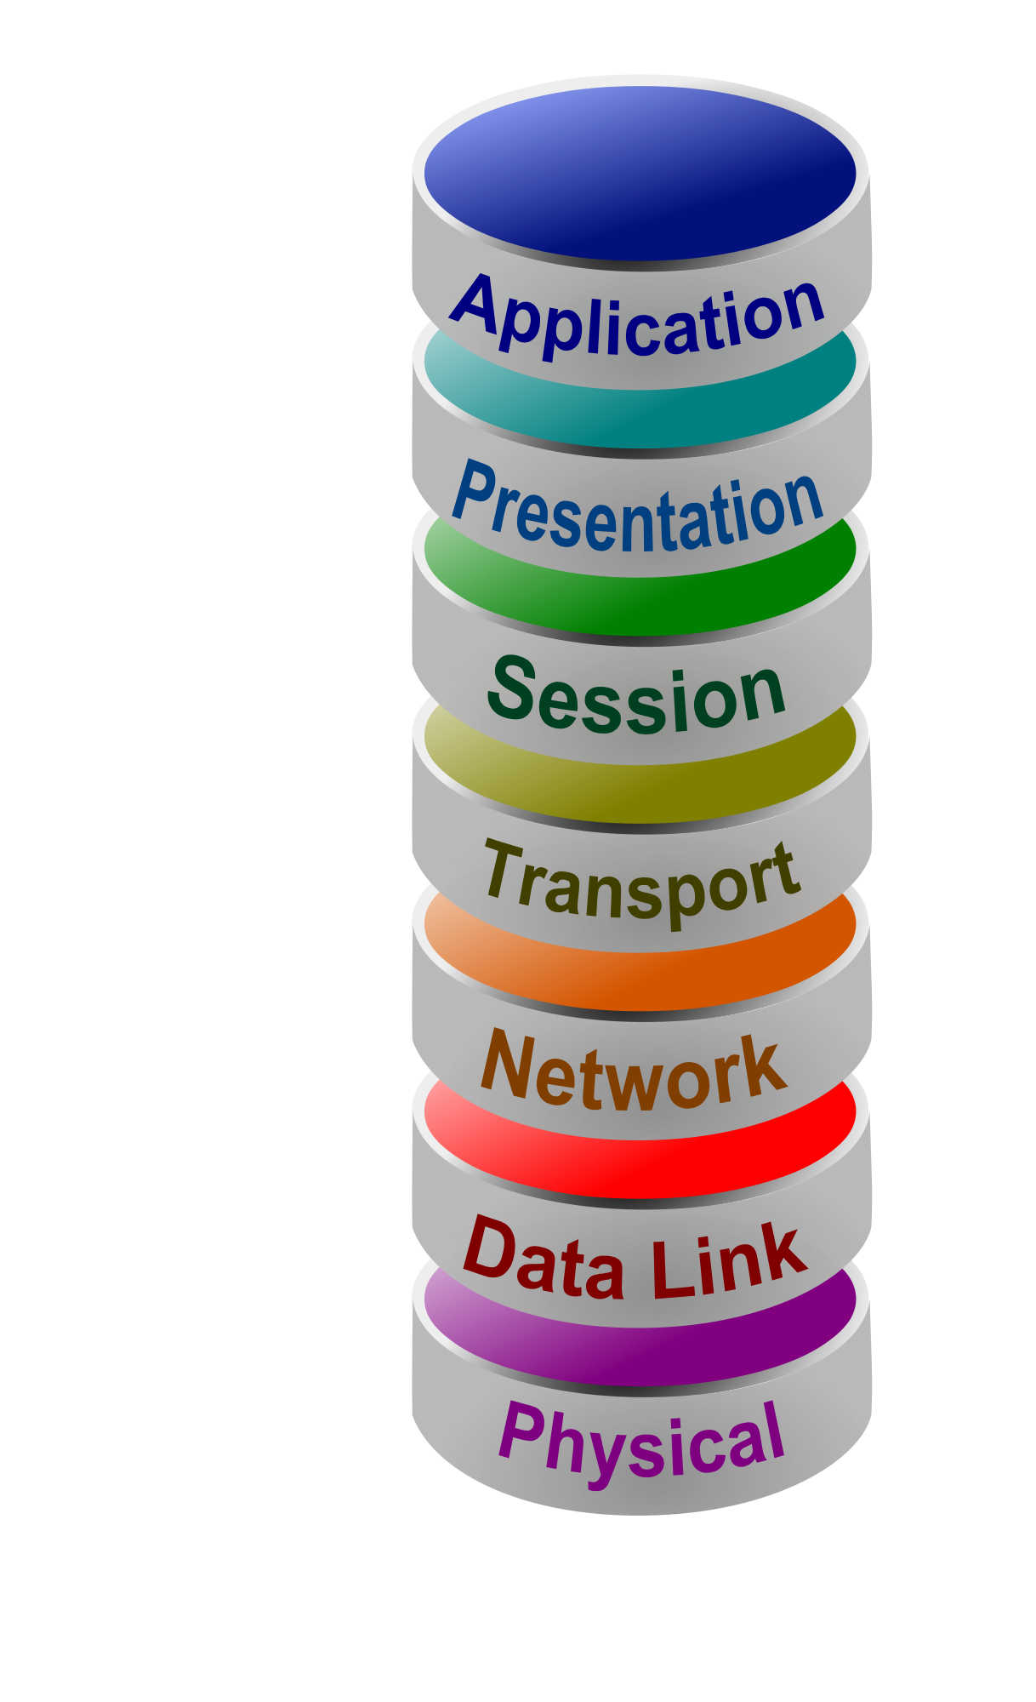
OSI networking model
Networks are structured as a series of layers
Each layer takes data from the layer above, packages it into a datagram format, and passes this to the layer below
There are two exceptions to this: the very topmost and bottommost layers:
  The physical layer represents hardware and passes raw bits on the physical network medium
  The application layer is expected to consume the data in some way

Slide 6
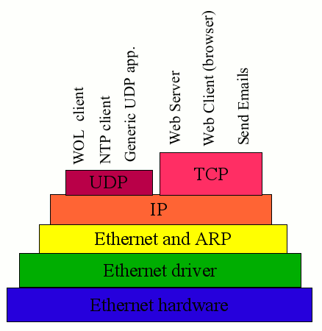
TCP/IP and UDP/IP stacks

Slide 7
Addressing
Each of these protocols have there own addressing schemes
Can anyone name the form of “address” used by:
  Ethernet
  WiFi
  IP
  TCP

Slide 8
What happens when you type google.ie into your browser?

Slide 9
What happens when you type google.ie into your browser?
A DNS lookup is performed to find the IP address
A HTTP request is created
The request is packaged into a TCP segment
The segment is packaged into an IP packet
The packet is packaged into a WiFi frame
The frame is transmitted over the network

Slide 10
Connecting the Pico
The Pico W has a built-in WiFi chip

Slide 11
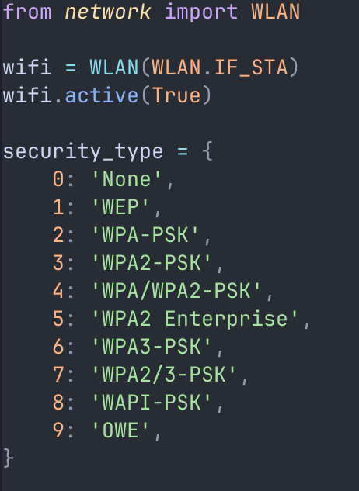
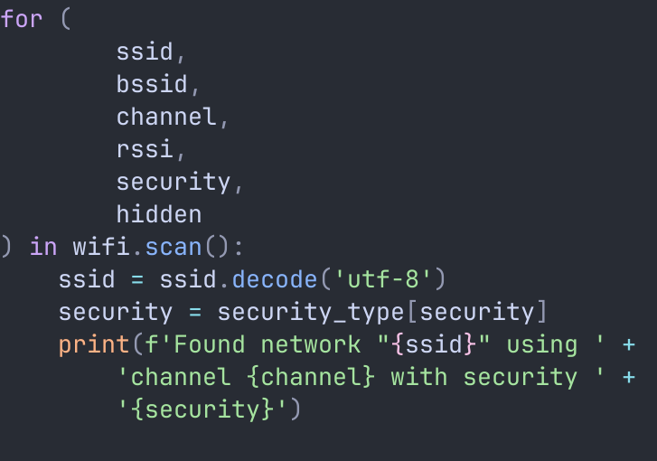
Scanning for networks

Slide 12

WiFi channels
WiFi uses radio configurations called channels. Unfortunately, the Pico only supports a subset of the channels that a typical laptop or phone would work with. In particular, it doesn't work with 5GHz channels, only the older 2.4GHz

Slide 13
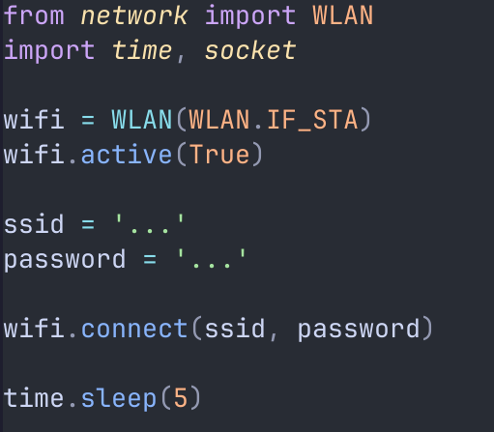
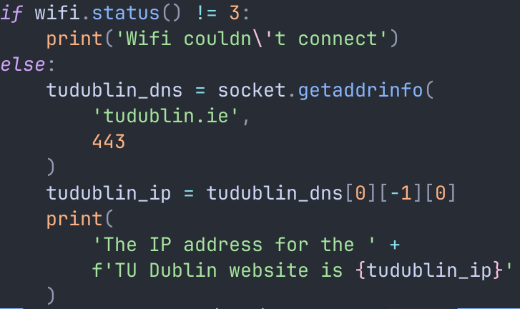
Connecting to a network

Slide 14
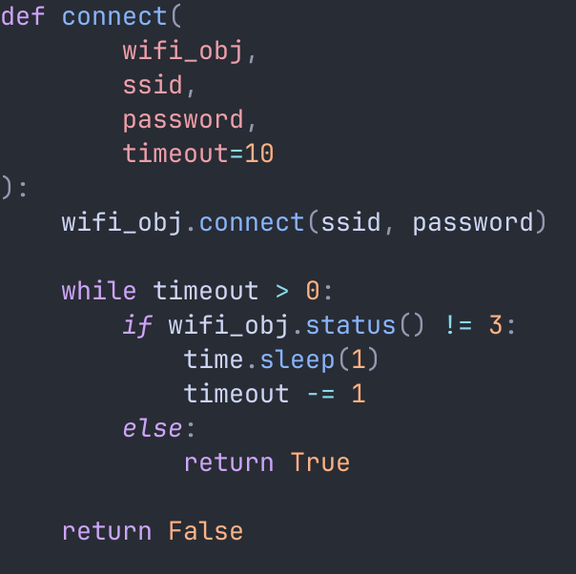
Function to connect to WiFi

Slide 15
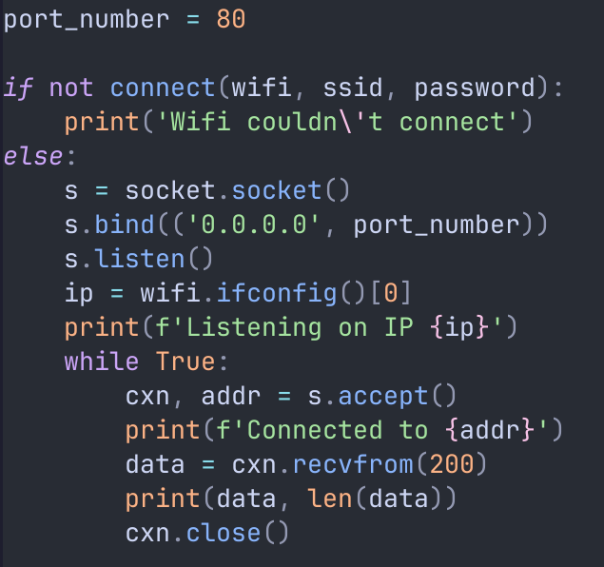
A very basic “server”

Slide 16

BSD sockets in Python
The only thing missing from the previous code snippet is using cxn.sendall() to send some raw Python bytes back to the client!
Link to tutorial

Slide 17
Dealing with Python bytes
Python distinguishes between the str (string) and bytes datatype

Slide 18
Dealing with bytes
Bytes-to-string: my_bytes.decode() (assumes UTF-8)
String-to-bytes: my_string.encode()
Bytes-to-int: each byte can be indexed into to get an integer, but are you sure you don’t want to convert to a string first?
Int-to-bytes: Create a list of integers in the range [0, 255], then pass it to bytes()

Slide 19
Useful methods on strings and bytes
Slicing [x:y] (inclusive of x, exclusive of y)
.index(query) and .find(query) Find the index of the first instance of the query
.startswith(query) Returns true if the object starts with query
.endswith(query) Returns true if the object ends with query

Slide 20
Summary
Went back over networking basics
How to scan for networks and connect to them on the Pico W using MicroPython
We can then use Python’s socket API (almost) the same way as in CPython
It’s important to understand how to use strings and bytes objects in Python effectively to work with these APIs

Slide 21
21
That’s all for this week
Thanks for your attention!

